Slide 1
Evaluating the impact of regulatory policies using tobacco sales data
Alex C. Liber PhD
Georgetown University
January 7, 2022
Tobacco Online Policy Seminar

Slide 2
Support
Funding from the Norwegian Cancer Society in the framework of a project partnership with the Polish Ministry of Health by leveraging funding from Norway Grants (Donor Partnership Project no. NMF.PL-NOR.DOI.PDP2_2 /20/3725/2020/80) and the Truth Initiative
Salary paid by TCORS grant U54CA229974 from the US National Cancer Institute and Food and Drug Administration
This Photo by Unknown Author is licensed under CC BY-SA

Slide 3
Co-Authors and Helpful Colleagues
David Levy
Christopher Cadham
Luz-Maria Sanchez Romero
Michael Pesko
Michal Stoklosa
Zachary Cahn
Megan Diaz
Emily Donovan
Barbara Schillo
Ken Warner
Jeffrey Drope
Holly Jarman
Scott Greer

Slide 4
Conflict of Interest Statement
I and co-authors of these studies have worked for organizations (American Cancer Society Inc, Truth Initiative, and the World Health Organization) that have adopted positions on the public policies being studied.
One article presented today (EVALI and US Tobacco Sales) had to clear internal review processes prior to publication
The opinions expressed here are my own and do not represent those of my employers, my co-authors, or their employers

Slide 5
Plan for the Grand Rounds
Regulatory Stances Framework
EVALI and US Tobacco Sales
Poland’s Menthol Cigarette Ban
Notes:
Today’s talk will be given in three parts: the first section will cram some political science theoretical construct development into this primarily econ-driven seminar when I introduce a framework to structure comparative regulation called the regulatory stances. Next I will dive into an empirical study of the first and second-order effects of the EVALI outbreak on US tobacco sales. Finally, I will present an empirical study

Slide 6
Regulatory Stances
Language for Comparative Regulation

Slide 7
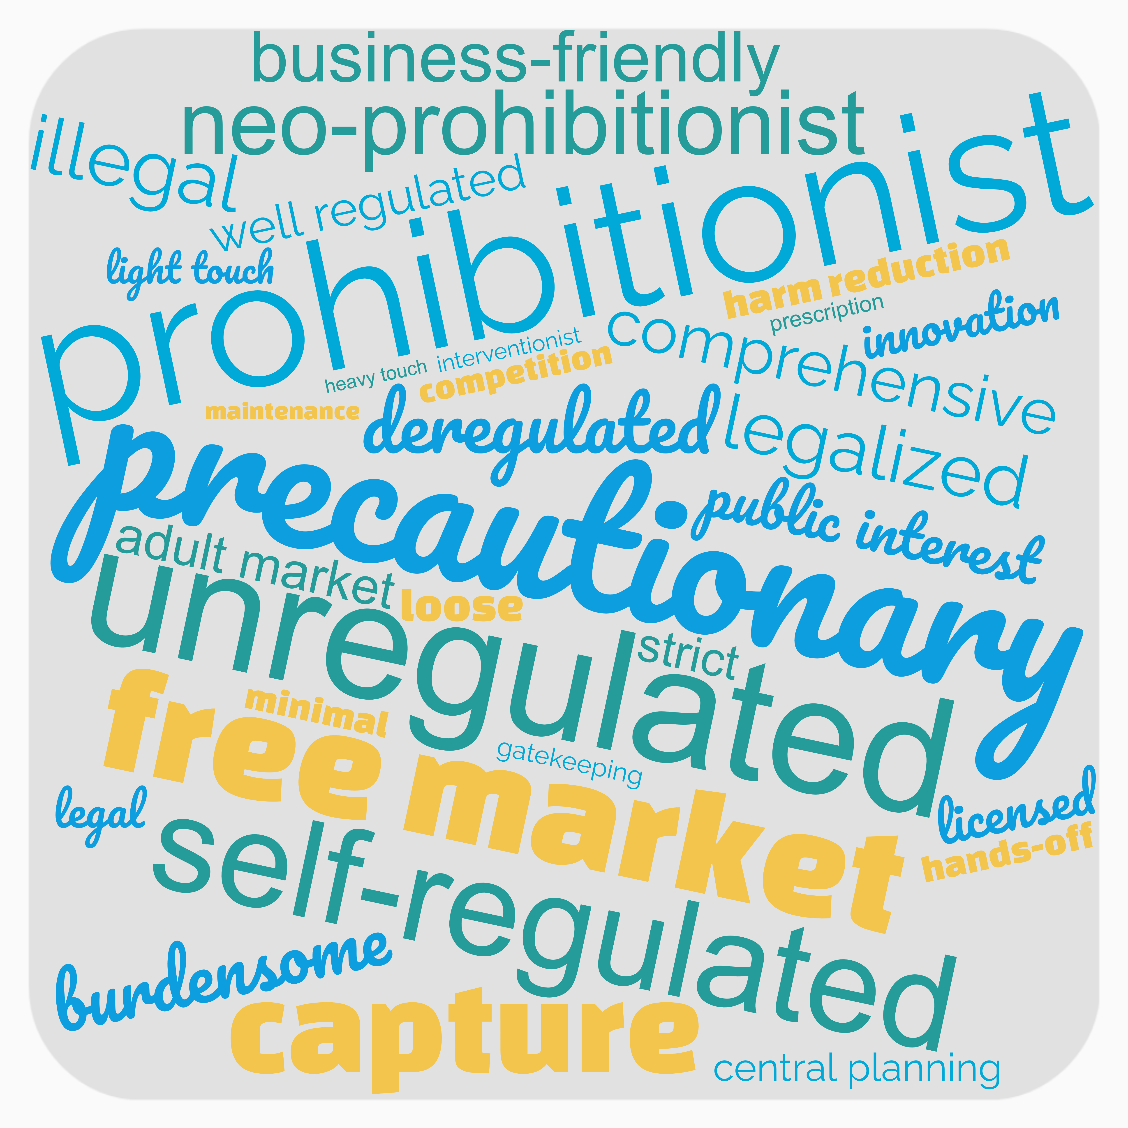
Language Used to Describe Regulation
Notes:
We use lots of words to describe regulation, regulatory policy, and policy preferences. Some of these words are imbued with positive emotions, others are decisively more negative. However, a language of comparative regulation has mostly been missing from the collective vocabulary of public policy scholar. Without such a language our discussions around policy preferences are not precise and are often characterized by opponents on different sides of regulatory policy issue not being able to agree on descriptions for their own position.

Slide 8
A Framework For Comparative Regulation
Market Failure
Regulation
Δ Market Size
Regulatory Stance
Notes:
Derived from my upcoming dissertation book Vape-Filled Rooms (University of Toronto Press exp. 2023. I do not consider myself to be an economist, I’m a political scientist who has trained in close proximity to health services researchers, epidemiologists and economists. I take the economists at their word that markets must be regulated to resolve market failures. I argue that any market failure has an implicit remedy via policies that intend to alter the size of a given market.
We need language to accurately communicate regulatory policy positions across markets, place, time and domain
If all regulations resolve a market failure → all regulations and policy preferences possess an intended effect on market size in the future relative to the present
This intended effect is referred to as a regulatory stance

Slide 9
The Range of Regulatory Stances
Prohibitionist
Permissive
Expansionist
Universalist
Market makes up
No size preference
Market makes up
Market is as large
Contractionist
Market makes up a
the economy
of the economy
is expressed
smaller portion
none of the
a larger portion of
as possible
economy
Notes:
I use a refinement of political scientist Robert Paarlberg’s framework developed to describe diverging regulatory policy towards genetically modified foods that I refer to as the range of regulatory stances. The primary measure used to determine a regulatory stance of a given jurisdiction towards a given market is the intended size of a market as a share of an economy in the future compared to the present. I argue that a regulatory stance can be determined for any market in any jurisdiction at any time. By assessing the competitive advantages and disadvantages provided to each market compared to its close substitute market (I argue one always exists) we can get an idea of the intended size of a market in the future compared to the present. The range of regulatory stances extends from prohibitionist stances which aim to decrease a markets size to zero all the way to universalist which seeks to expand a market to the largest extent possible. I believe that most markets are typically subject to a regulatory stance in between these extremes, wherein some markets receive a contractionist stance that seeks to decrease the size of a market while other are subject to expansionist stances that seek to increase the size of a market. Other markets are not subject to a size preference or provided explicit advantages or disadvantages and are deemed subject to a permissive stance.

Slide 10
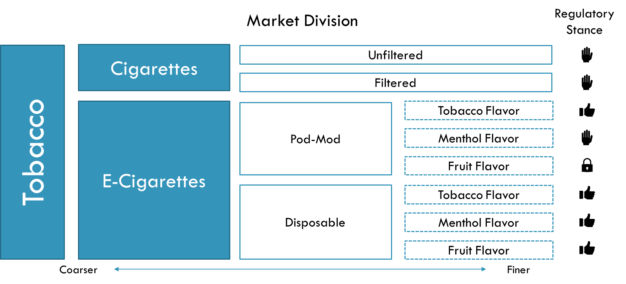
An Example Application
Policy Domains
Usage
Marketing
Retail
Pricing
Product Standards
Notes:
So, as an example, I create market division and policy domain charts to organize the application of the regulatory stances concept. If we look at two close substitute markets cigarettes and e-cigarettes (I’m taking this as an empirical reality for argument’s sake) we can see an example of how a regulatory policy, that say limited sales of say non-tobacco pod-mod e-cigarettes would create competitive advantages and disadvantages for different market divisions, thereby leading to changes in market size over time. I envision these policies as arising from actions across different policy domains like public usage or pricing. Some policy decisions in certain domains could be more consequential than others, but I believe that when looking across a wide enough array of policy we can glean the regulatory stance for a given market division. As regulations are further developed to say ban the use of filters in cigarettes

Slide 11
An Example Application
Policy Domains
Usage
Marketing
Retail
Pricing
Product Standards
Notes:
As regulations are further developed to say ban the use of filters in cigarettes, then we might see that changing a product standard to prohibit one product would cause another product to grow and place further downward pressure on a market as a whole. The regulatory stances concept is flexible enough to be able to prioritize effects in one domain over others to produce and overall regulatory stance.

Slide 12
Why Use Regulatory Stances?
A regulatory stance always exists
Common, non-derogatory parlance with inherent meaning
Articulates policy preferences, positions, and effects
Notes:
In sum, I believe that regulatory stances concretely define and actuate a concept in comparative regulation that can clearly articulate policy preferences, positions, and effects. We can and should use regulatory stances to open discussions of comparative regulation to a wider range markets and disciplines. The top reasons why we should use regulatory stances are as follows: A regulatory stance always exists for all markets in all places. Lessons can be drawn from anywhere <click> A regulatory stance for a given market has inherent meaning and is not derogatory, meaning policy stakeholders should be able to identify one another’s positions without causing unnecessary hurt or miscommunication. <click> And in doing such policy preference articulation, attention is focused on especially market size which I view to be a productive lens for policy innovation. For example, in the realm of e-cigarettes and cigarette regulation, we speak ad nauseum about gateway effects and directionality between e-cigarette and cigarette use. Once we accept that the two products are substitutes, then we might view a gateway effect between them not as an unalterable law of physics but as a product of regulatory policy choices. If we want there to be no gateway effects from e-cigarettes to cigarettes, then quickly contracting the market for cigarettes seems like a good way to get rid of worrisome gateway effects.

Slide 13
EVALI and US Tobacco SALES
Notes:
Now I’ll speak about my first empirical piece, which was published in the journal Tobacco Control last month. I worked on this piece with Zach Cahn, Megan Diaz, Barbara Schillo, Emily Donovan, and Donna Vallone. The last four authors work for the Truth Initiative’s Schroeder Institute. Zach and I started work on this paper while we were employees of American Cancer Society Inc.

Slide 14
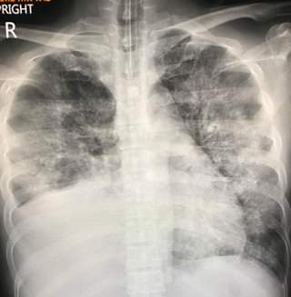
What was EVALI?
Vitamin E Acetate containing cannabis vaping products were responsible
Media attention on e-cigarettes was the strongest ever recorded
2807 hospitalizations and 68 deaths by February 2020
This Photo by Unknown Author is licensed under CC BY
Notes:
“E-cigarette, or Vaping, product use Associated Lung Injury” Outbreak
Emergent care visits stemming from the use of vaping products, primarily containing THC started around the end of July 2019
Concentrated among young people in the US

Slide 15
E-Cigarette Sales Before and After EVALI
Notes:
E-Cigarette sales in the US experienced rapid, nearly uninterrupted growth in mass market retailers from 2017 through the middle of 2019 when they suddenly plunged. What was responsible for this sudden change of fortune? The EVALI outbreak looks like the primary candidate

Slide 16
EVALI: The Government Response
FDA combined concern for EVALI with concern over rising youth e-cigarette usage rates to propose federal ban on flavored e-cig sales
7 states proposed, 5 implemented temporary bans on sale of nontobacco flavored e-cigs
Massachusetts banned sales of all e-cigarettes for 90 days, before reverting to a nontobacco flavored e-cig sales ban
Notes:
Trump admin proposed banning sales of all non-tobacco flavored e-cigarettes
Scaled back to limit sales to only tobacco or menthol flavors in refillable e-cigarettes

Slide 17
Research Questions
How did the EVALI outbreak directly affect sales of e-cigarettes?
How did the policy changes passed in the wake of EVALI affect sales of e-cigarettes?
How did the above affect cigarette sales?

Slide 18
Regulatory Stances Parlance
Partial (Flavored) E-Cigarette Ban
Tobacco Flavor E-Cigarette →
Menthol Flavor E-Cigarette →
All E-Cigarettes →
Young Brand Cigarettes →
All Cigarettes →
Total E-Cigarette Ban
Tobacco Flavor E-Cigarette →
Menthol Flavor E-Cigarette →
All E-Cigarettes →
Young Brand Cigarettes →
All Cigarettes →

Slide 19
Data
Total E-Cig
Tobacco Flavor Refills
Menthol Flavor Refills
Other Flavor Refills
Hardware
Sales of e-cigarettes and tobacco cigarettes in 23 US states: January 2014 – February 2020
Nielsen Scantrack
Convenience, Food, and Drug
Excludes Online and Vape Shop
>70% E-Cig $ Sales
>90% Cig $ Sales
Total Cig
Young Brands
Age-Proportionate Brands
Old Brands

Slide 20
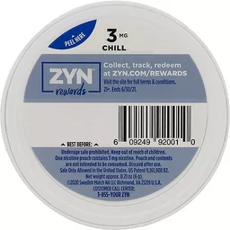
Universal Product Codes
Source: Johns Hopkins TPackSS

Slide 21
Data (Continued)
Outcome Variable: Differenced, Indexed Per-Capita Unit Volumes
Total E-Cig Sales
Split by Refill Category + Hardware
Total Cigarette Sales
Split by Brand Group
Primary Input Variables (Differenced)
State Total Ban Days
State Partial Ban Days
EVALI Outbreak Measures (Differenced Indexed to Maxima)
EVALI Hospitalizations (Retroactive)
Media Coverage of E-cigarettes
EVALI Cases (Contemporaneous)
EVALI Deaths (Contemporaneous)

Slide 22
NSDUH 2015—2018 Share of Brands Consumed by Respondents Under 21
Notes:
Self-reported numbers of cigarettes smoked during the past month by each current smoker was multiplied by analytical survey weights to calculate overall brand shares as well as the share of each brand consumed by consumers under and over age 21. Those brands that were disproportionately consumed by those under 21 (significantly more than the population average of 1.8% of cigarettes in the NSDUH sample) and those brands that were consumed by almost no-one under 21 (less than 0.05% of cigarettes) were designated as disproportionately young and disproportionately old brands, respectively.

Slide 23
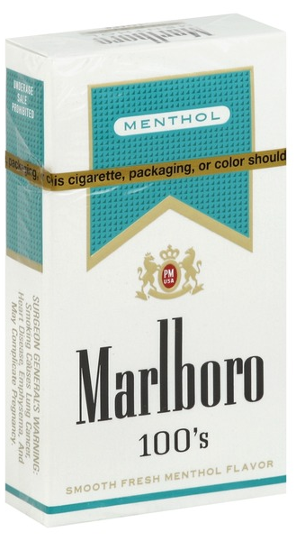
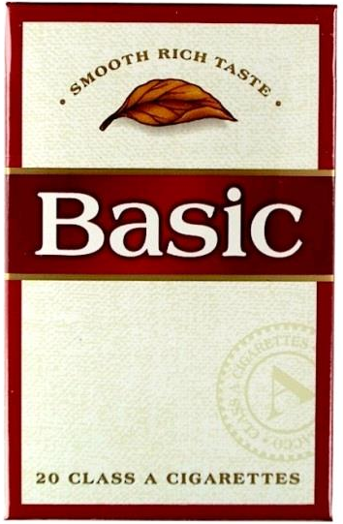
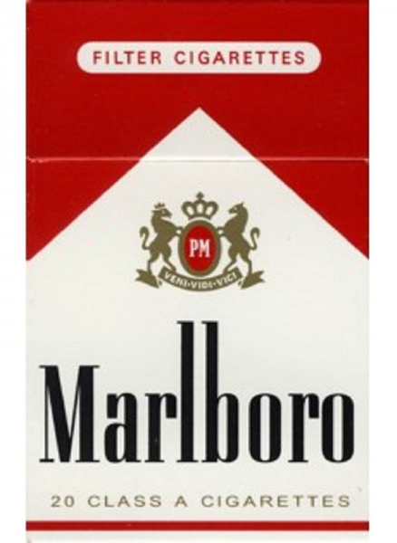
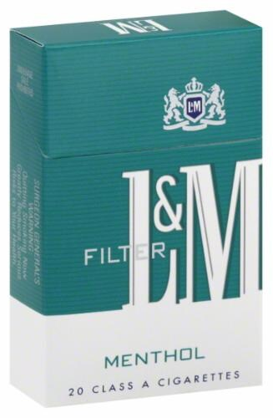
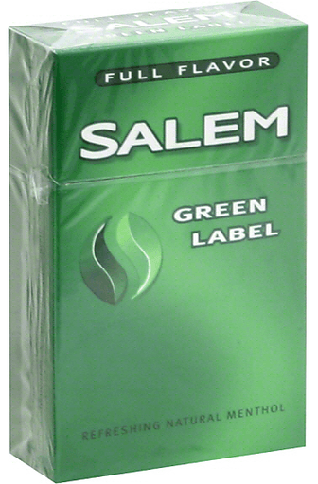
Disproportionately Young
Age-Proportionate
Disproportionately Old
Notes:
Each UPC in the Nielsen data was assigned the “disproportionately young”, “disproportionately old”, or “age-proportionate” brand groups based on the NSDUH; and volume sales, value sales, and price of each brand group were aggregated by DMA. Five brands representing 31.5% of cigarette consumption in the NSDUH data and 28.3% of cigarette sales by volume in the Nielsen data (Marlboro Menthol, L&M Menthol, Newport Regular, Camel Menthol, and Newport Menthol) were designated as disproportionately young brands. Eight brands representing 2.2% of cigarette consumption in the NSDUH data and 3.5% of cigarette sales by volume in the Nielsen data (Basic Regular, Doral Menthol, Doral Regular, Misty Menthol, Misty Regular, Salem Menthol, Virginia Slims Menthol and Virginia Slims Regular) were designated as disproportionately old brands. Age-proportionate brands represent 66.1% of cigarette consumption in the NSDUH data and 68.3% of cigarette sales by volume in the Nielsen data represented the remainder.

Slide 24
Data (Continued)
Secondary Input Variables (All Differenced):
Time
Price – Inflation-adjusted average unit price
Tobacco 21 – Coverage (% of Population)
Weather – Heating Degree Days (HDD), Differenced Proportion of Days Where Heat Must be Turned On
HDD * HDD Mean – Unseasonably Cold Weather
Distribution – Weighted proportion of stores reporting sales of a given category
JUUL Fruit and Mint Distribution – Differenced, Distribution of JUUL’s Fruit and Mint Flavored Pods

Slide 25
US E-Cigarette Sales and EVALI Outbreak Measurement Variables
We determined which measure of the EVALI outbreak best fit changes in sales using BIC for total e-cigarette sales on simple and full models
Deaths fit best

Slide 26
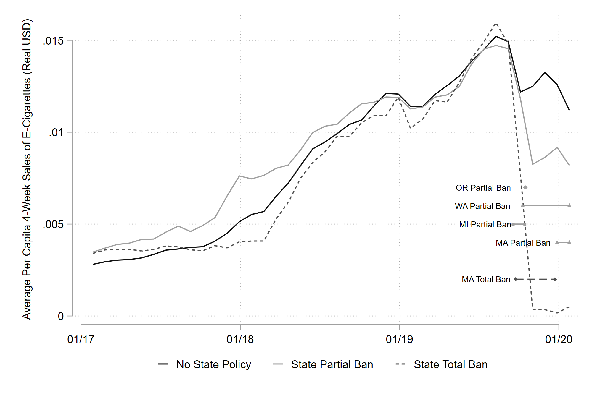
EVALI and E-Cigarette Sales
Average Per Capita Sales of E-Cigarettes By State E-Cigarette Policy Group
January 2017 – January 2020

Slide 27
Category-Level Sales of E-Cigarettes
Average Per Capita Sales of E-Cigarettes By State E-Cigarette Policy Group
January 2017 – January 2020

Slide 28
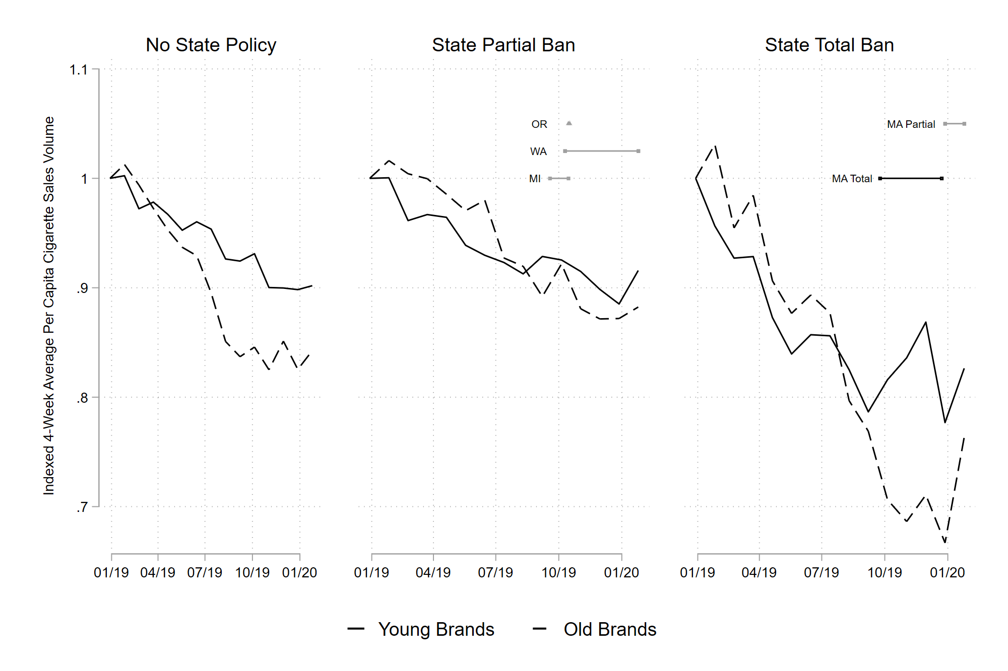
EVALI and Cigarette Sales
Average Per Capita Cigarette Sales by E-Cigarette Policy and Brand Age Category
Adjusted for Seasonal Consumption Patterns
December 2018 – January 2020

Slide 29
First-Differenced Results for Log-Differenced TOTAL E-Cigarette Sales and by Product Category
 | Total | Hardware | Other Flavors | Menthol Flavor | Tobacco Flavor
EVALI Deaths | -0.106* | -0.381* | -0.321* | 0.00153 | -0.0299
State Total Ban Days | -2.343* | -2.786* | -1.252 | -0.473 | -1.489*
State Partial Ban Days | -0.830 | -0.542 | -2.987 | -2.400* | 0.196
Population Mean | 0.0193 | 0.0111 | 0.0315 | 0.0158 | 0.0132
Population Std Dev | 0.1189 | 0.2358 | 0.2667 | 0.2023 | 0.1063
Note: * p < 0.05, All 23 panels except Michigan (n=68, starting in November 2014) have 78 observations. Covariate results are not displayed. Standard errors are clustered at the state level.
Notes:
At the top, EVALI directly decreased total e-cigarette sales, while a total ban decimated the e-cigarette market. Oddly, the partial bans seem to appear to only have a small effect on sales in these results, but we believe that is due to some confounding from MA as I’ll explain on the next slide. We find that total sales rose as the weather got colder, and fell as prices got higher. In a first, we also find that e-cigarette sales declined in response to T21 passage. Finally, Distribution variables indicate that total distribution and JUUL fruit distribution were associated with rising total sales of e-cigarettes.

Slide 30
First-Differenced Results for Log-Differenced TOTAL E-Cigarette Sales and by Product Category (WITHOUT MASSACHUSETTS)
 | Total | Hardware | Other Flavors | Menthol Flavor | Tobacco Flavor
EVALI Deaths | -0.0578* | -0.343* | -0.181* | 0.0907* | 0.0133
State Partial Ban Days | -0.226* | -0.152* | -1.282* | -1.305* | 0.751*
Population Mean | 0.0211 | 0.0124 | 0.0365 | 0.0200 | 0.0144
Population Std Dev | 0.0886 | 0.2243 | 0.2072 | 0.1435 | 0.0893
Michigan, Oregon, Washington
Massachusetts
Note: * p < 0.05, All 22 panels except Michigan (n=68, starting in November 2014) have 78 observations. Covariate results are not displayed. Standard errors are clustered at the state level.
Notes:
Once Massachusetts is excluded from the study sample, the effect of state partial bans becomes significant and negative. <Click>This sensitivity test is important because Massachusetts adopting a partial ban represented moving from a prohibitionist policy to a contractionist policy while in other states the partial ban represented a move from a permissive policy to contractionist. We see negative effects on sales of all e-cigarettes expect Tobacco flavor once MA is removed.

Slide 31
First-Differenced Results for Log-Differenced TOTAL Cigarette Sales AND by Brand Group
 | Total | Young Brands | Age-Proportional Brands | Old Brands
EVALI Deaths | -0.00460* | -0.00686* | -0.00352* | -0.00754*
State Total Ban Days | 0.0414* | 0.0813* | 0.0274* | 0.00960
State Partial Ban Days | -0.0115 | -0.0144 | -0.00972 | -0.0382*
Population Mean | -0.0026 | -0.0010 | -0.0030 | -0.0092
Population Std Dev | 0.0388 | 0.0442 | 0.0372 | 0.0638
Note: * p < 0.05, All 23 panels except Michigan (n=68, starting in November 2014) have 78 observations. Covariate results are not displayed. Standard errors are clustered at the state level.
Notes:
Oddly, sales of cigarettes are down during the EVALI outbreak. There isn’t a good pattern here to explain this, so I’ll leave it be for the moment. Most interesting to us is the policy-related changes. We see a state total e-cigarette sales ban is associated with higher cigarette sales, with the effect size being largest for disproportionately young cigarette brands followed by age proportionate brands, and no effect for disproportionately old brands. This is what we’d expect to see if young-skewing vapers suddenly had to move to cigarettes to get their nicotine fix. Also of import, we do not observe an increase in sales of any cigarette group due to a partial ban on e-cigarettes, even though we saw e-cigarette sales tumble in response to these policies everywhere except MA.

Slide 32
Conclusions
E-cigarette sales declined in response to the EVALI outbreak, and in response to policy-response measures limiting the sale of e-cigarettes
Sales of cigarettes rose during MA’s total ban on e-cigarette sales
No rise in cigarette sales could be observed in reaction to the EVALI outbreak or partial e-cigarette sales bans
Policies restricting e-cigarette sales may not always generate the worst-possible outcomes of substitution toward cigarettes
Notes:
Sales of cigarettes rose in reaction to the Massachusetts total ban on e-cigarette sales in a fashion that suggests substitution from e-cigarettes to cigarettes drove the change

Slide 33
Poland’s Menthol Cigarette Ban

Slide 34
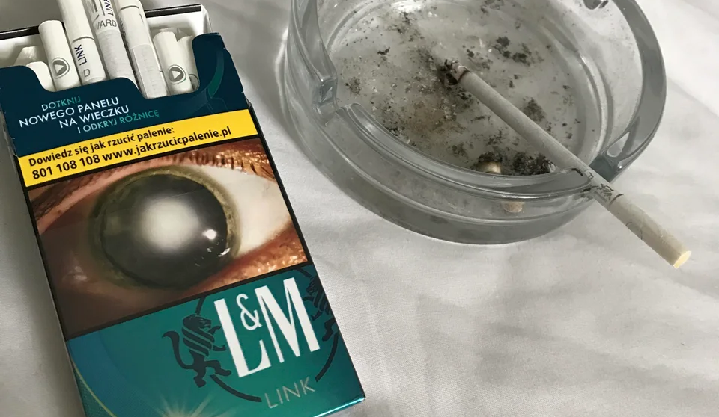
European Union Menthol Ban
In May 2020 menthol cigarette sales ended across the EU
Prior analyses of the effects of menthol cigarette sales bans have come from areas with menthol cigarette shares or small areas with legal access to menthol cigarettes elsewhere
Menthol cigarettes →
Standard cigarettes →
All cigarettes →

Slide 35
Menthol Ban Evaluation
Poland had much higher menthol cigarette sales share before ban than any prior country that has attempted to ban menthol cigarettes
Objective: Use a bite-style difference-in-differences regression, measure whether cigarette sales declined after the menthol ban
Data: NielsenIQ sales data for May 2018 to April 2021
Notes:
Poland’s menthol cigarette share was (28.1%) before the ban.
This regression exploits a differences in exposure to a “treatment” (the share of menthol cigarettes before the ban) to determine the effect of the treatment (the menthol cigarette sales ban.
Lots to control for especially around COVID

Slide 36
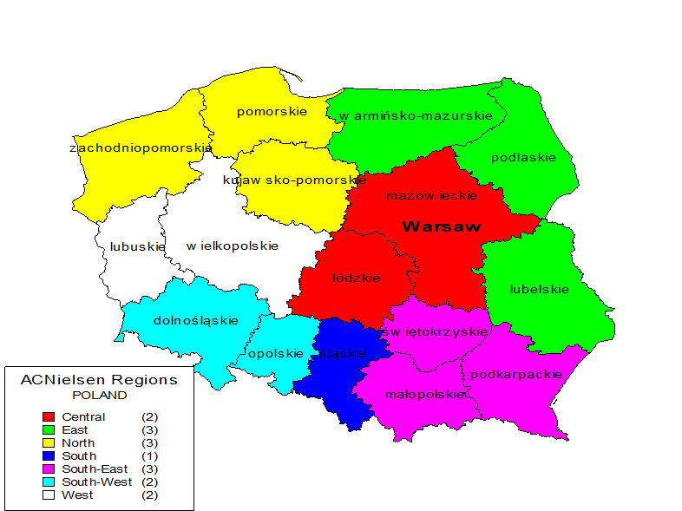
Data Detail
Sales of Cigarettes and Roll-Your-Own Tobacco
8 regions (Warsaw City, Central, West, East, North, South, South-East, and South-West)
Split by flavor
Notes:
Data on sales of cigarettes and RYO was collected from grocery stores, discounters, hypermarkets, sweet alcohol stores, kiosks, petrol stations, and tobacconists. In 2019, Nielsen data covered 80% of Poland’s cigarette sales and 70% of RYO tobacco sales

Slide 37
GLM Regression Analysis with MLE
$${Per Capita Cigarette Sales}_{it}=$$
$α+β_{1}Menthol Ban+β_{2}\left({Menthol Ban}_{t}∗{May 2018 Menthol Share}_{i}\right)+β_{3}{Heating Degree Days}_{it}+β_{4}{EU Border Status}_{it}+β_{5}{Non EU Border Status}_{it}+β_{6}{Walking}_{it}+β_{7}{Employment Rate}_{it}+β_{8}{Price}_{it}+ω_{t}+θ_{i}+ε_{it}$
Clustered Std Err at Regional Level and Region Fixed Effects

Slide 38
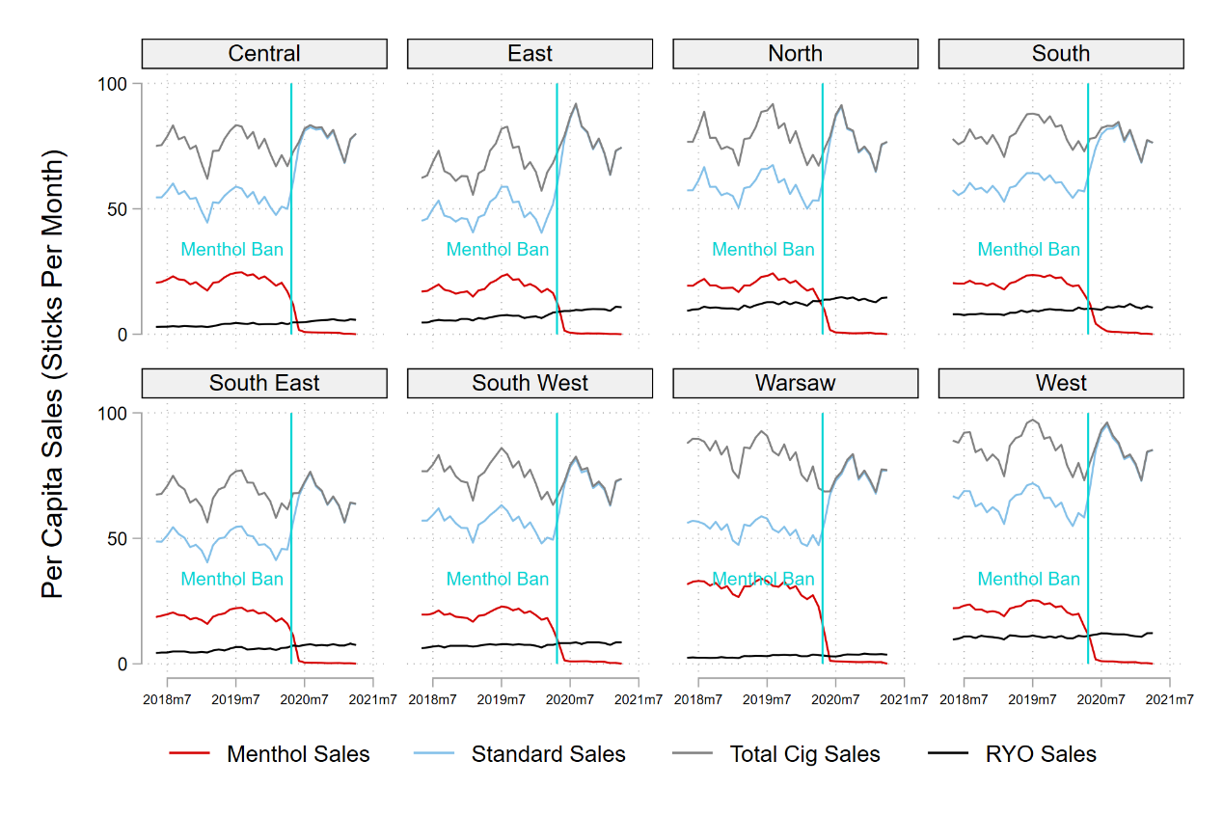
Per Capita Cigarette Sales by Nielsen Region (May 2018—April 2021)
Menthol sales are replaced by standard cigarettes after the ban
RYO sales continue growing after the ban
Was this menthol to standard replacement enough to stop any loss in total cigarette sales?
Notes:
Descriptive stats

Slide 39
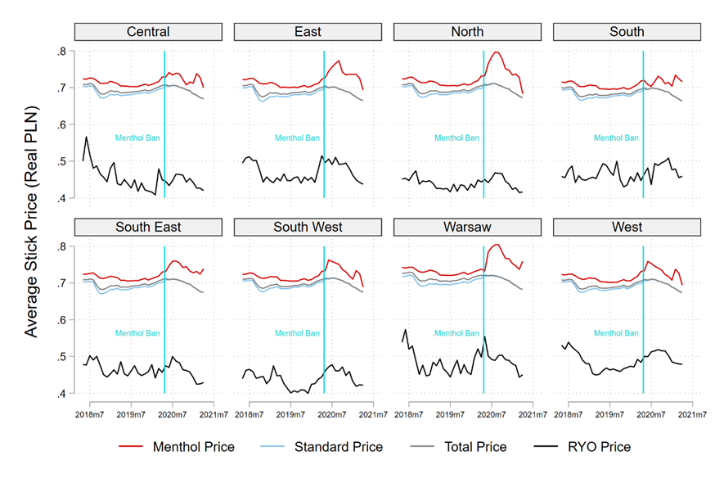
Regional average cigarette price (Real PLN per stick, May 2018—April 2021)
Prices dropped across all remaining legal categories

Slide 40
Cigarette Sales Event Study
Notes:
Beginning of the multivariate model. This analysis does not cleanly pass a Wald test, but it hovers around zero before plunging right after the introduction of the menthol ban. Any initial decline in cigarette sales is clawed back after about 3 months, i.e. the time when prices fell.

Slide 41
RYO Sales Event Study
Notes:
RYO had a much smaller share of menthol flavored tobacco, and we see a much smaller effect size.

Slide 42
Fully-Adjusted Regression Results for Per Month Per Capita Total Cigarettes and Roll-Your-Own Tobacco
 | Cigarettes | Cig + Price | RYO | RYO + Price
Post | 12.87* | 15.83** | 2.312* | 2.320*
Pre-Menthol Share # Post | -15.02*** | -16.86*** | -2.285* | -2.288*
Time Trend | 0.0908 | 0.0314 | 0.0883*** | 0.0881***
Heating Degree Days | -13.15*** | -14.26*** | -0.574*** | -0.575***
EU Border Open | 8.446*** | 4.528** | 0.0103 | 0.00536
Non-EU Border Open | -6.766* | -7.371* | -1.110* | -1.110*
Walking Volume | 3.695*** | 4.939*** | 0.222 | 0.222
Employment Rate | 0.865* | 1.380*** | 0.105 | 0.107
Average Price (PLN Real) |  | -7.594*** |  | -0.118
Constant | -15.29 | 154.1 | 13.38 | 13.64
Mean Menthol Ban Effect Size | -2.15 | -1.032 | 0.0272 | 0.0326
Mean Menthol Ban Effect P-Value | 0.199 | 0.561 | 0.798 | 0.841
* p < 0.05, ** p < 0.01, *** p < 0.001
Notes:
The top two terms are the bite variable and main interaction term. For a region with a mean menthol share of 28.1%, sales declined by 2.15 sticks per month in the model where price is not taken into account.

Slide 43
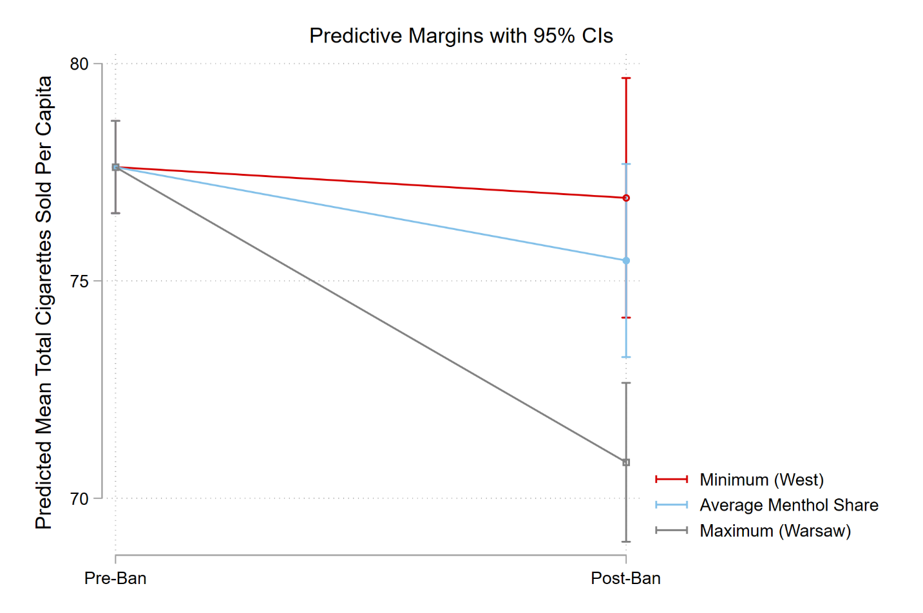
Change in Sales by Pre-Ban Menthol Share
Only Warsaw saw a significant decline in cigarette sales

Slide 44
Results: Translated
EU Menthol Ban did not significantly decrease total cigarette sales in Poland
Regions with more menthol share at baseline saw larger declines post ban
Cigarette prices fell after the ban, potentially to stop early sales declines
EU border closures decreased sales in regions with such a border
Non-EU border closures increased sales in regions with such a border

Slide 45
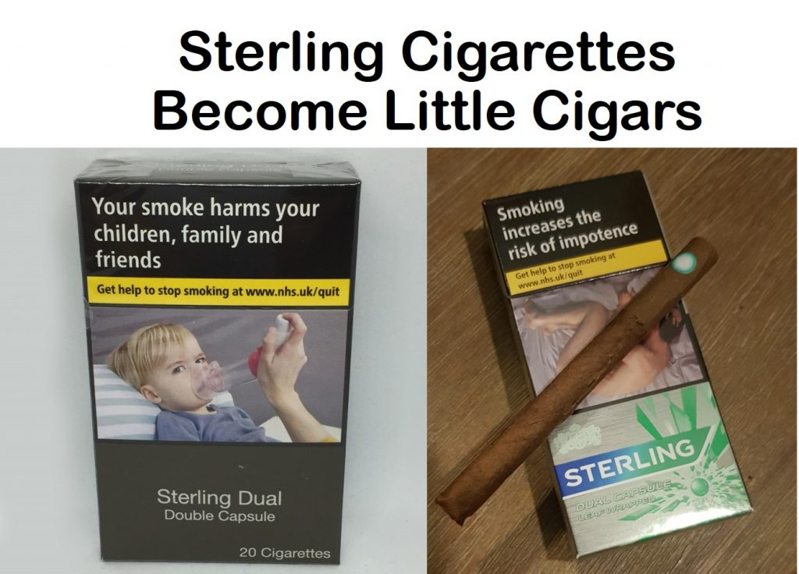
Menthol Cigarette Ban Evasion
Tobacco companies have openly reformulated, released new tobacco products, and flavoring products to evade the menthol ban
Whether these products are causing the menthol cigarette ban to fall short of expectations should be evaluated

Slide 46
Lessons

Slide 47
Sales Data
Passively collected, enormously useful
Can be split and analyzed in creative ways to tell a deeper story
However, analysis needs to be more timely
This is the first public presentation of sales data evaluating a policy implemented in May 2020!
The collection and dissemination of granular sales data for surveillance purposes must be more readily accessible and systematic
Enables more comparative policy evaluation!
Notes:
Access to this sort of data, especially outside of the US, is prohibitively expensive

Slide 48
Regulatory Policy
Checking for unintended consequences of policy change is essential
Improve implementation by quickly identifying gaps between expectations and outcomes
Extend evaluations of e-cigarette flavor bans to permanent sales bans
Examine tensions between short and long run outcomes
Notes:
to see if similar findings are reached compared to temporary bans

Slide 49
SALES Before, DURING, and AFTER EVALI
CDC Foundation: https://bit.ly/3mYwhc7

Slide 50
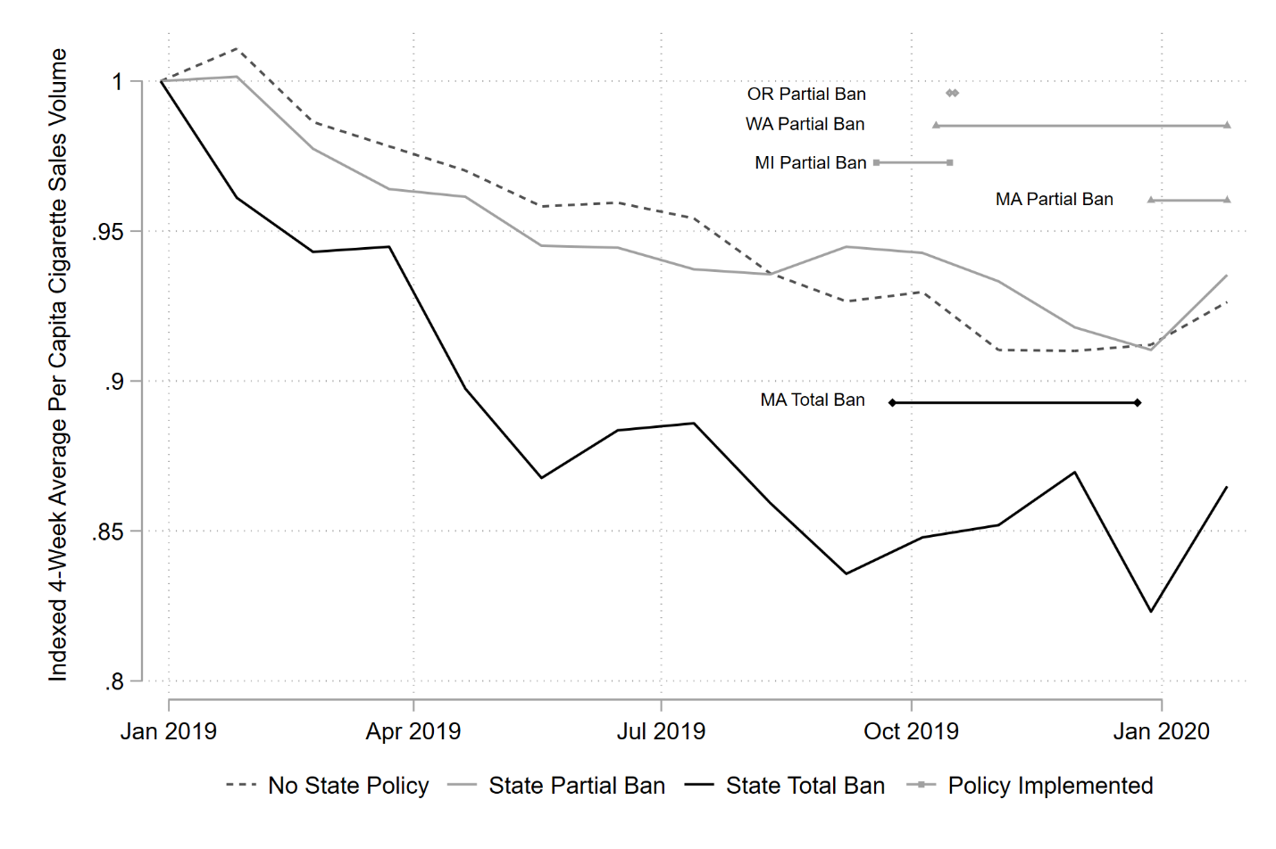
Average Cigarette Sales per Capita, December 2018 – January 2020, by E-Cigarette Policy

Slide 51
First-Differenced Results for Log-Differenced TOTAL Cigarette Sales and by Brand Group (WITHOUT MASSACHUSETTS)
 | Total | Young Brands | Age-Proportional Brands | Old Brands
EVALI Deaths | -0.00437* | -0.00652* | -0.00335 | -0.00636*
State Partial Ban Days | -0.00487 | -0.00197 | -0.00509 | -0.0289*
Population Mean | -0.0026 | -0.0009 | -0.0029 | -0.0093
Population Std Dev | 0.0388 | 0.0443 | 0.0371 | 0.0643
Note: * p < 0.05, All 22 panels except Michigan (n=68, starting in November 2014) have 78 observations. Year-period dummies are not displayed. Standard errors are clustered at the state level.
Notes:
Notably, the removal of MA does not meaningfully affect the estimates of the effects of partial bans on cigarette sales. The only significant effect is a decline in old brand sales, which looks spurious an unimportant to us.

Slide 52
Total E-cigarette Sales: Sensitivity Check
 | Original | No Policy | No EVALI
EVALI Deaths | -0.0578* | -0.0599*
State Total Ban Days
State Partial Ban Days | -0.226* |  | -0.235*
Heating Degree Days | 0.00246* | 0.0022 | 0.00257*
Price | -0.196* | -0.209* | -0.176*
Tobacco 21 Coverage | -0.0879* | -0.0836* | -0.0976*
Heating Degree Days # HDD Mean | -0.000112 | -9.59E-05 | -0.000124
Distribution | 0.00187* | 0.00191* | 0.00189*
JUUL Fruit Distribution | 0.0209* | 0.0209* | 0.0211*
JUUL Mint Distribution | -0.00206* | -0.00186* | -0.000259
Constant | -0.00343 | -0.0029 | -0.00401
sigma_u
Constant | 0 | 0 | 0
sigma_e
Constant | 0.0776* | 0.0778* | 0.0779*
Observations | 1706 | 1706 | 1706
bic | -3724.8 | -3714.4 | -3712.2
ll | 1940.6 | 1935.3 | 1934.3
Note: * p < 0.05, All 23 panels except Michigan (n=68, starting in November 2014) have 78 observations. Year-period dummies are not displayed. Standard errors are clustered at the state level.

Slide 53
E-cigarette Hardware Sales: Sensitivity Check
 | Original | No Policy | No EVALI
EVALI Deaths | -0.343* | -0.345*
State Total Ban Days
State Partial Ban Days | -0.152* |  | -0.239*
Heating Degree Days | 0.00479* | 0.00461* | 0.00568*
Price | -0.708* | -0.711* | -0.584*
Tobacco 21 Coverage | -0.0735 | -0.0713 | -0.144*
Heating Degree Days # HDD Mean | -0.000334* | -0.000324* | -0.000419*
Distribution | 0.00903* | 0.00903* | 0.00910*
JUUL Fruit Distribution | 0.0390* | 0.0390* | 0.0433*
JUUL Mint Distribution | -0.00442* | -0.00421* | 0.00523*
Constant | -0.0542* | -0.0538* | -0.0626*
sigma_u
Constant | 0 | 0 | 0
sigma_e
Constant | 0.185* | 0.185* | 0.189*
Observations | 1706 | 1706 | 1706
bic | -758.2 | -757.4 | -689
ll | 457.3 | 456.8 | 422.6
Note: * p < 0.05, All 23 panels except Michigan (n=68, starting in November 2014) have 78 observations. Year-period dummies are not displayed. Standard errors are clustered at the state level.

Slide 54
E-cigarette Hardware Sales: Sensitivity Check
 | Original | No Policy | No EVALI
EVALI Deaths | -0.106* | -0.153
State Total Ban Days | -2.343* |  | -2.399*
State Partial Ban Days | -0.83 |  | -0.878
Heating Degree Days | 0.00409* | 0.00296* | 0.00434*
Price | -0.147 | -0.239* | -0.109
Tobacco 21 Coverage | -0.0771* | -0.0466 | -0.0950*
Heating Degree Days # HDD Mean | -0.000228 | -0.000167 | -0.000252
Distribution | 0.00185* | 0.00217* | 0.00189*
JUUL Fruit Distribution | 0.0203* | 0.0215* | 0.0207*
JUUL Mint Distribution | -0.00415* | -0.00445 | -0.000879
Constant | -0.00169 | 0.00691 | -0.00301
sigma_u | 1784 | 1784 | 1784
Constant | -3137.9 | -2684.1 | -3109
sigma_e | 1651.3 | 1424.4 | 1636.8
Constant | -0.106* | -0.153
Observations | -2.343* |  | -2.399*
bic | -0.83 |  | -0.878
ll | 0.00409* | 0.00296* | 0.00434*
Note: * p < 0.05, All 23 panels except Michigan (n=68, starting in November 2014) have 78 observations. Year-period dummies are not displayed. Standard errors are clustered at the state level.

Slide 55
First-Differenced Results for Log-Differenced TOTAL E-Cigarette Sales and by Product Category
 | Total | Hardware | Other Flavors | Menthol Flavor | Tobacco Flavor
EVALI Deaths | -0.106* | -0.381* | -0.321* | 0.00153 | -0.0299
State Total Ban Days | -2.343* | -2.786* | -1.252 | -0.473 | -1.489*
State Partial Ban Days | -0.830 | -0.542 | -2.987 | -2.400* | 0.196
Heating Degree Days | 0.00409* | 0.00595* | 0.00637 | 0.00339 | 0.00190
Price | -0.147 | -0.731* | -1.165* | -0.725* | -0.0238
Tobacco 21 Coverage | -0.0771* | -0.0613 | -0.414* | 0.362* | 0.0549
Heating Degree Days x Mean HDD | -0.000228 | -0.000403* | -0.000298 | -0.000329 | -0.000101
Distribution | 0.00185* | 0.00924* | 0.00644* | 0.00339* | 0.00258*
JUUL Fruit Distribution | 0.0203* | 0.0384* | 0.0191* | -0.0120* | -0.00760*
JUUL Mint Distribution | -0.00415* | -0.00585* | -0.00485 | -0.00330 | -0.00529*
Constant | -0.00169 | -0.0570* | -0.000294 | 0.00726 | -0.0104
Population Mean | 0.0193 | 0.0111 | 0.0315 | 0.0158 | 0.0132
Population Std Dev | 0.1189 | 0.2358 | 0.2667 | 0.2023 | 0.1063
Note: * p < 0.05, All 23 panels except Michigan (n=68, starting in November 2014) have 78 observations. Year-period dummies are not displayed. Standard errors are clustered at the state level.
Notes:
At the top, EVALI directly decreased total e-cigarette sales, while a total ban decimated the e-cigarette market. Oddly, the partial bans seem to appear to only have a small effect on sales in these results, but we believe that is due to some confounding from MA as I’ll explain on the next slide. We find that total sales rose as the weather got colder, and fell as prices got higher. In a first, we also find that e-cigarette sales declined in response to T21 passage. Finally, Distribution variables indicate that total distribution and JUUL fruit distribution were associated with rising total sales of e-cigarettes.

Slide 56
First-Differenced Results for Log-Differenced TOTAL E-Cigarette Sales and by Product Category (WITHOUT MASSACHUSETTS)
 | Total | Hardware | Other Flavors | Menthol Flavor | Tobacco Flavor
EVALI Deaths | -0.0578* | -0.343* | -0.181* | 0.0907* | 0.0133
State Partial Ban Days | -0.226* | -0.152* | -1.282* | -1.305* | 0.751*
Heating Degree Days | 0.00246* | 0.00479* | 0.00284 | 0.000903 | 0.000609
Price | -0.196* | -0.708* | -1.035* | -0.704* | -0.0364
Tobacco 21 Coverage | -0.0879* | -0.0735 | -0.439* | 0.335* | 0.0436
Heating Degree Days x Mean HDD | -0.000112 | -0.000334* | -4.36E-05 | -0.000133 | -1.28E-05
Distribution | 0.00187* | 0.00903* | 0.00809* | 0.00348* | 0.00251*
JUUL Fruit Distribution | 0.0209* | 0.0390* | 0.0189* | -0.0102* | -0.00678*
JUUL Mint Distribution | -0.00206* | -0.00442* | -0.000523 | 0.000266 | -0.00339*
Constant | -0.00343 | -0.0542* | -0.00263 | -0.0077 | -0.0127*
Population Mean | 0.0211 | 0.0124 | 0.0365 | 0.0200 | 0.0144
Population Std Dev | 0.0886 | 0.2243 | 0.2072 | 0.1435 | 0.0893
Note: * p < 0.05, All 22 panels except Michigan (n=68, starting in November 2014) have 78 observations. Year-period dummies are not displayed. Standard errors are clustered at the state level.
Notes:
Once Massachusetts is excluded from the study sample, the effect of state partial bans becomes significant and negative. This sensitivity test is important because Massachusetts adopting a partial ban represented moving from a prohibitionist policy to a contractionist policy while in other states the partial ban represented a move from a permissive policy to contractionist. We see negative effects on sales of all e-cigarettes expect Tobacco flavor once MA is removed.

Slide 57
First-Differenced Results for Log-Differenced TOTAL Cigarette Sales AND by Brand Group
 | Total | Young Brands | Age-Proportional Brands | Old Brands
EVALI Deaths | -0.00460* | -0.00686* | -0.00352* | -0.00754*
State Total Ban Days | 0.0414* | 0.0813* | 0.0274* | 0.00960
State Partial Ban Days | -0.0115 | -0.0144 | -0.00972 | -0.0382*
Heating Degree Days | -0.00341* | -0.00402* | -0.00332* | -0.00233*
Price | -0.513* | -0.530* | -0.536* | -1.118*
Tobacco 21 Coverage | -0.00463 | -0.0172* | 0.000887 | -0.00968
Heating Degree Days x Mean HDD | 0.0000935* | 0.000138* | 0.0000824 | 0.0000618
Distribution | 0.0000958 | 0.000634* | 0.0000956 | 0.00239*
Constant | -0.0474* | -0.0540* | -0.0451* | -0.0403*
Population Mean | -0.0026 | -0.0010 | -0.0030 | -0.0092
Population Std Dev | 0.0388 | 0.0442 | 0.0372 | 0.0638
Note: * p < 0.05, All 23 panels except Michigan (n=68, starting in November 2014) have 78 observations. Year-period dummies are not displayed. Standard errors are clustered at the state level.
Notes:
Oddly, sales of cigarettes are down during the EVALI outbreak. There isn’t a good pattern here to explain this, so I’ll leave it be for the moment. Most interesting to us is the policy-related changes. We see a state total e-cigarette sales ban is associated with higher cigarette sales, with the effect size being largest for disproportionately young cigarette brands followed by age proportionate brands, and no effect for disproportionately old brands. This is what we’d expect to see if young-skewing vapers suddenly had to move to cigarettes to get their nicotine fix. Also of import, we do not observe an increase in sales of any cigarette group due to a partial ban on e-cigarettes, even though we saw e-cigarette sales tumble in response to these policies everywhere except MA. Beyond this, we see again that T21 caused declines in the sale of young cigarette brands, and that cigarette sales still respond to price and changes in the weather. Interestingly, young cigarette brand sales seem to be more responsive to the weather, but that’s a vein for future work!

Slide 58
First-Differenced Results for Log-Differenced TOTAL Cigarette Sales and by Brand Group (WITHOUT MASSACHUSETTS)
 | Total | Young Brands | Age-Proportional Brands | Old Brands
EVALI Deaths | -0.00437* | -0.00652* | -0.00335 | -0.00636*
State Partial Ban Days | -0.00487 | -0.00197 | -0.00509 | -0.0289*
Heating Degree Days | -0.00351* | -0.00410* | -0.00342* | -0.00250*
Price | -0.0054 | -0.0181* | 0.000187 | -0.0116
Tobacco 21 Coverage | -0.527* | -0.546* | -0.548* | -1.127*
Heating Degree Days x Mean HDD | 0.000103* | 0.000145* | 0.0000934* | 0.0000735
Distribution | 0.000091 | 0.000597* | 0.0000918 | 0.00223*
Constant | -0.0462* | -0.0530* | -0.0439* | -0.0390*
Population Mean | -0.0026 | -0.0009 | -0.0029 | -0.0093
Population Std Dev | 0.0388 | 0.0443 | 0.0371 | 0.0643
Note: * p < 0.05, All 22 panels except Michigan (n=68, starting in November 2014) have 78 observations. Year-period dummies are not displayed. Standard errors are clustered at the state level.
Notes:
Notably, the removal of MA does not meaningfully affect the estimates of the effects of partial bans on cigarette sales. The only significant effect is a decline in old brand sales, which looks spurious an unimportant to us.

